Slide 1


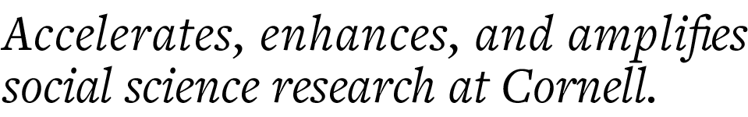
Natural Language Processing 101
Remy Stewart
CCSS-ResearchSupport@cornell.edu

Slide 2
CCSS Research Support Code of Conduct
The Cornell Center for Social Sciences provides a welcoming environment for everyone embracing all backgrounds or identities. All instructors and attendees agree to abide by our community norms. We encourage the following behaviors in our workshops:
Respect differing viewpoints and ideas
Share your own perspectives and ask any questions
Accept constructive criticism
Use welcoming and inclusive language
Show courtesy and respect for all instructors and attendees
If you believe that an instructor or attendee has violated the code of conduct, please report the violation to CCSS-RS@cornell.edu. We take all reported incidents seriously.

Slide 3
Land Acknowledgement
Cornell University is located on the traditional homelands of the Gayogo̱hó꞉nǫ' (the Cayuga Nation). The Gayogo̱hó꞉nǫ' are members of the Haudenosaunee Confederacy, an alliance of six sovereign Nations with a historic and contemporary presence on this land. The Confederacy precedes the establishment of Cornell University, New York state, and the United States of America. We acknowledge the painful history of Gayogo̱hó꞉nǫ' dispossession, and honor the ongoing connection of Gayogo̱hó꞉nǫ' people, past and present, to these lands and waters.
Here are additional links for more on the history of Cornell’s violent, colonial formation, the movement to return native lands, and about the AIISP program at Cornell.
Consider donating to the Gayogo̱hó꞉nǫʼ sovereignty initiative here.

Slide 4
Workshop Outline
Introduction
Text Preprocessing Code Demo
Dictionaries & Sentiment Analysis
Sentiment Analysis Code Demo
Additional Methods
Ethics
Conclusion
Open Q & A

Slide 5

Text as Data
Text has always been an integral data source within social science research
Often has been limited to qualitative methods due to lacking applicable tools, computational resources, and sharp methods learning curves
Information Age has rapidly shifted these circumstances:
Wide range of emergent innovative methods
Cheaper and more powerful compute resources
Open-source software that is accessible to learn

Slide 6
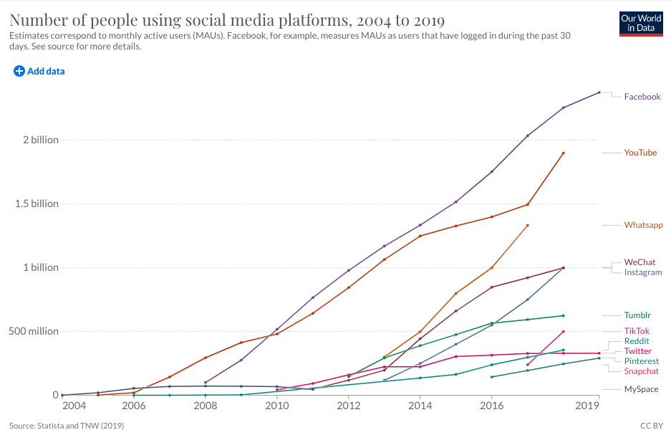
Digital Trace Data
Text data is being created rapidly as more written behavior is recorded online
Digital traces or footprints of our thoughts, feelings, behaviors, and relationships embedded in text
Closely linked to the explosive growth of social media & online communities

Slide 7
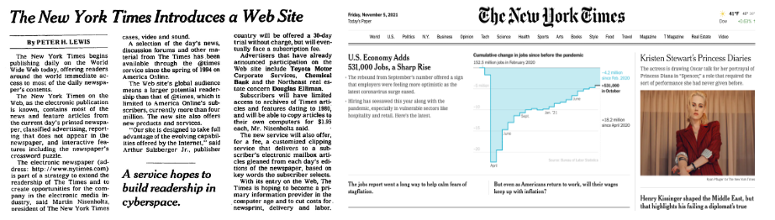
Digitization of Printed Text
Digital conversion of books, historical records, government documents, etc.
Transition of previously print-exclusive mediums to digital platforms

Slide 8

Natural Language Processing (NLP)
Interdisciplinary field of using computational tools to interpret text & language
Powering the AI behind language translation, audio-to-text transcription, speech recognition (Siri, Alexa, etc.), and beyond
Growing ability to navigate context, similarity, varied meanings, and social implications within language
Increasingly more accessible for non-specialists with working programming knowledge

Slide 9
Computational Social Sciences (CSS)
“Development and application of computational methods to complex, typically large-scale, human (sometimes simulated) behavioral data” (Lazer et al. 2009: 721)
NLP as a natural computational approach to integrate within social science research
Wide usability across social science disciplines & research topics

Slide 10
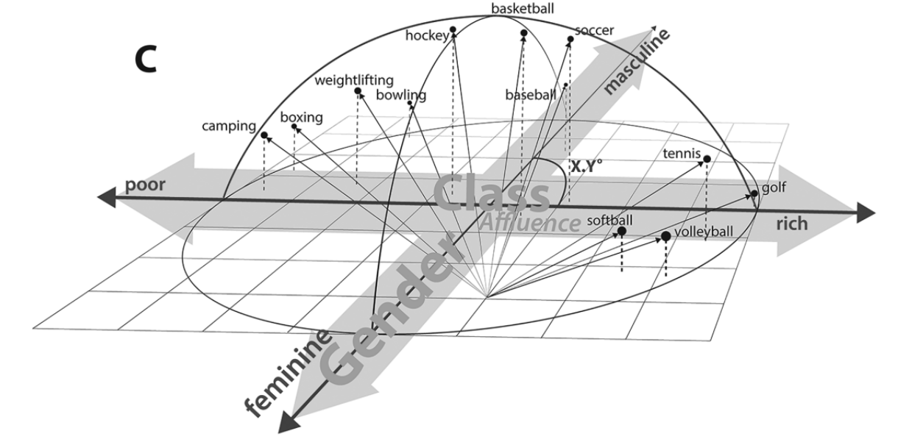
Word embeddings from Kozlowski, Taddy, and Evans (2019)

Slide 11
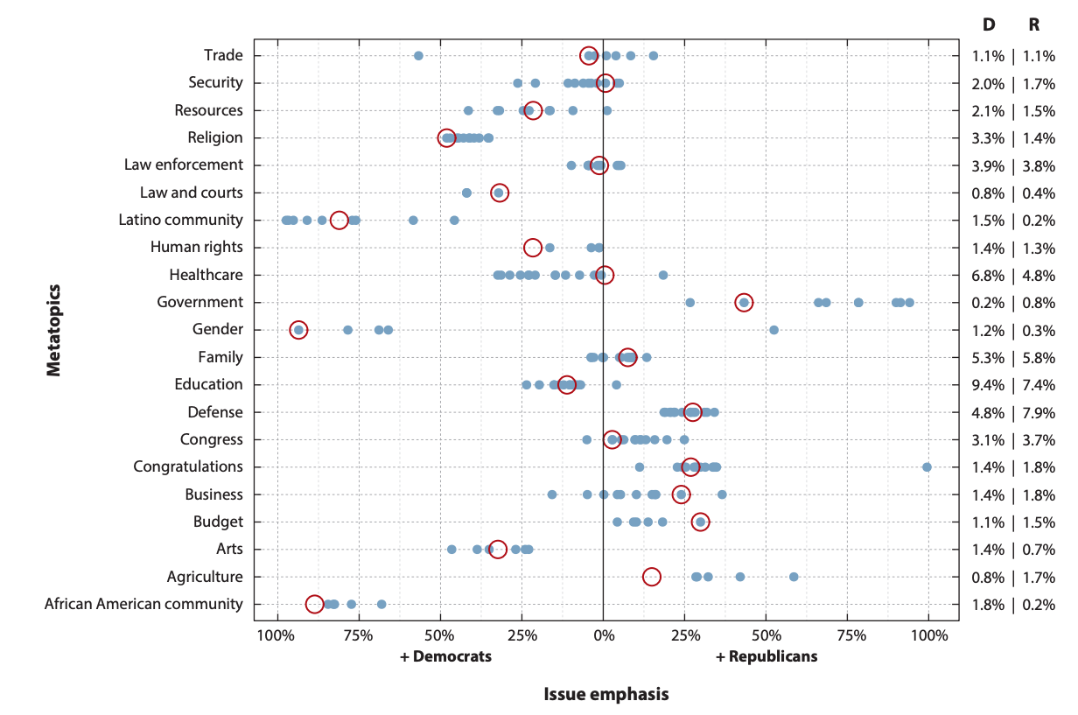
Structural Topic Models from Wilkerson & Casas (2017)

Slide 12
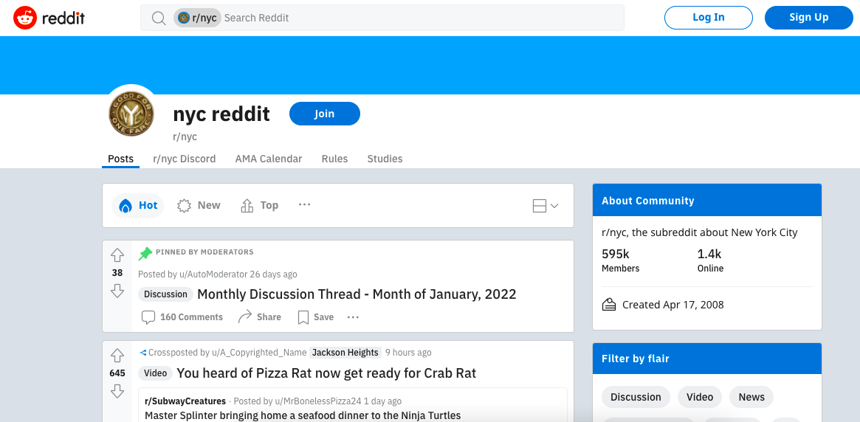
Reddit & r/nyc
Reddit is an online social media platform built around subreddits focused on conversation topics
Easier to access text data compared to other social media platforms
Very popular platform for NLP-based social science research given its range of subcommunities
Our data set features 10,000 unique comments sourced from r/nyc, the subreddit focused on New York City

Slide 13
Core Terminology
1. A corpus is the total collection of text being analyzed.
All 10k of our r/nyc Reddit comments
2. A vocabulary is the entire collection of words in a corpus.
All words used at least once across the comment sample
3. A document is an individual record within the corpus.
A user posts “My favorite pizza place in Hell’s Kitchen is 99 Cent Fresh Pizza.”
4. Tokens are the smaller text units within a document. Most commonly refers to individual words, but can also be sentences, paragraphs, or individual characters.
“My,” “favorite,” “pizza,” “place”, ….
5. N-grams considers multiple word tokens at once with “n” as a specified number.
Bi-gram of “Hell’s_Kitchen” Tri-Gram of “New_York_City”

Slide 14
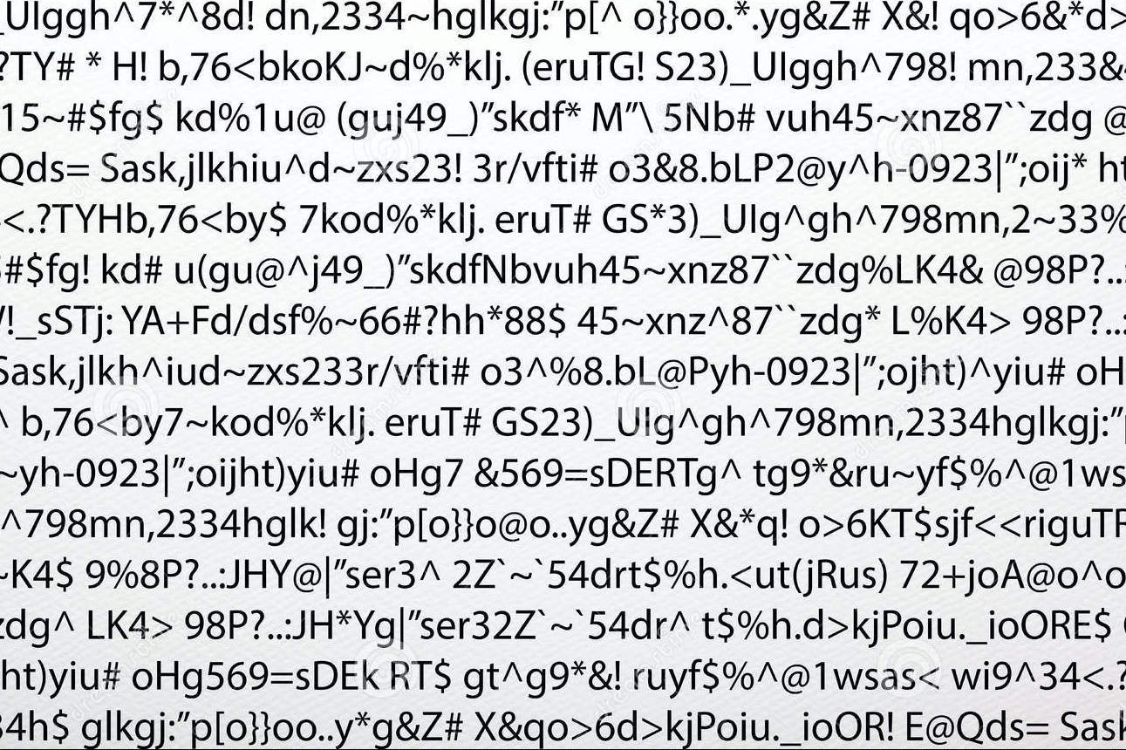
Text Pre-Processing
Not as glamorous of a subject, but absolutely essential
Text data- particularly sourced from digital mediums- is full of noise
Different NLP methods require different pre-processing steps
Pre-processing choices really, really matter
Models can be inaccurate if done incorrectly
Can lead to very different results with different pre-processing decisions
Important step to test robustness of your findings
(Definitely have encountered this level of noise within my own work!)

Slide 15
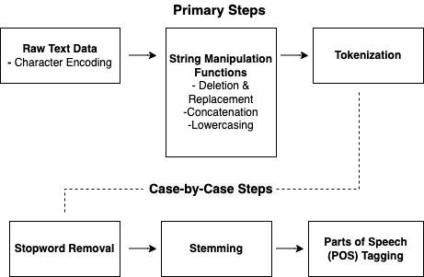
Let’s see these steps in action in our first code demo!
Pre-Processing Demo Workflow

Slide 16
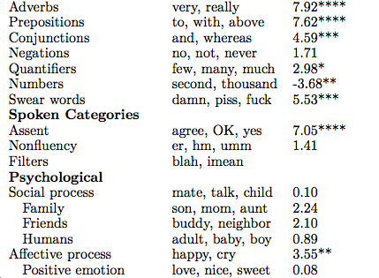
Word Counts & Dictionaries
Dictionary-based methods use designated lexicons of words designed to measure concepts of interest
Tied to word counts as the fundamental process underlying many NLP methods
Can be individually created or downloaded as a pre-made dictionary
Linguistic Inquiry Word Count (LIWC) as a common dictionary within the social sciences
Features over 70 categories covering linguistic features & psychological metrics
Other pre-made dictionaries cover diverse topics such as power, morality, toxicity, etc.
Selection of LIWC dictionaries

Slide 17
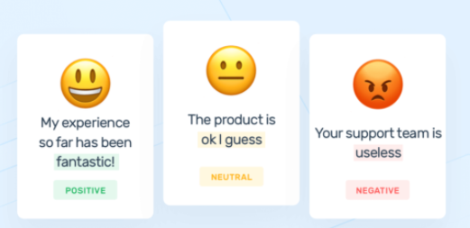
Sentiment Analysis
Identifies individual words as expressing positive, negative, or neutral sentiments and generates scores of the overall sentiment within text
Popular in industry applications such as product customer review, recommendation systems, and social media analysis
Increasingly used within social sciences to explore public opinion, political polarization, community relationships, etc.
Often measured either through dictionaries or supervised classification machine learning
Need to consider sentiment/emotional expression variation by context

Slide 18
VADER
Valence Aware Dictionary and Sentiment Reasoner (VADER) was originally written in Python but available for R via VADER package.
VADER is often used for studies drawing from Reddit data since it accounts for unique lexical features of social media text.
Let’s explore VADER in greater detail in our second code demo!

Slide 19
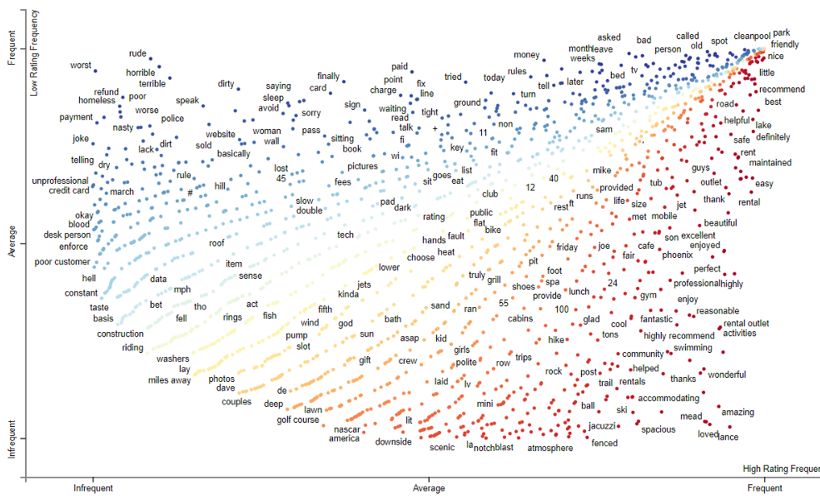
Additional NLP Methods
We’ve only scratched the surface of NLP, its core concepts, and its application within R
A wide range of additional methods that build from the introduced fundamentals
We’ll go through a brief overview of NLP methodological sub-topics including:
Supervised learning
Text & Causality
Unsupervised learning
Text Networks
Refer to the user guide’s references for further reading- highly encourage to explore potential use for your own research!
(Visual created by George Hou’s “Analyzing Yelp Dataset With Scatterplot spaCy”)

Slide 20


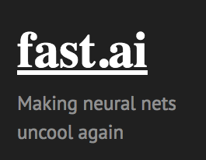


Supervised Learning
Generates predictions on text data’s class membership through learning relationships on labeled data
Traditional machine learning includes regression, tree-based, support vector machines, etc.
Deep learning/neural network frameworks powering NLP within AI
Only becoming more and more accessible for anyone with baseline Python/R skills
Particularly recommend Hugging Face, Fast.AI, & Tidymodels libraries

Slide 21
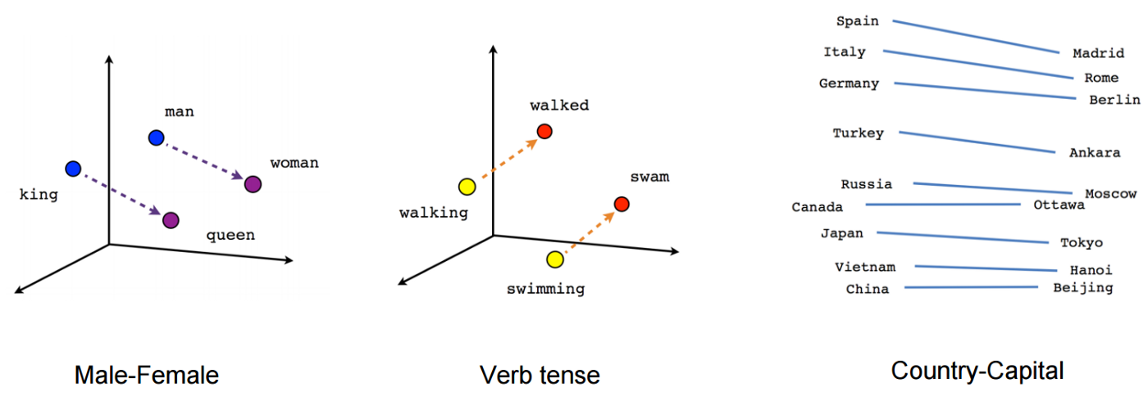
Unsupervised Learning
Unsupervised learning based on machine learning algorithms that uncover emergent clusters, patterns, and themes within text data without prior labels
Topic Models assign words to a selected number of topics based on their co-occurrence across documents
Efficient at identifying primary subjects, discussion points, named entities, etc. across a full corpus
Find an additional code demo with our r/nyc data using topic models in the user guide!
Word Embeddings encode vocabularies into lower-dimensional number vectors
Effectively captures similarities & word group concepts
Famous for answering analogies such as “king - man + woman = queen”

Slide 22
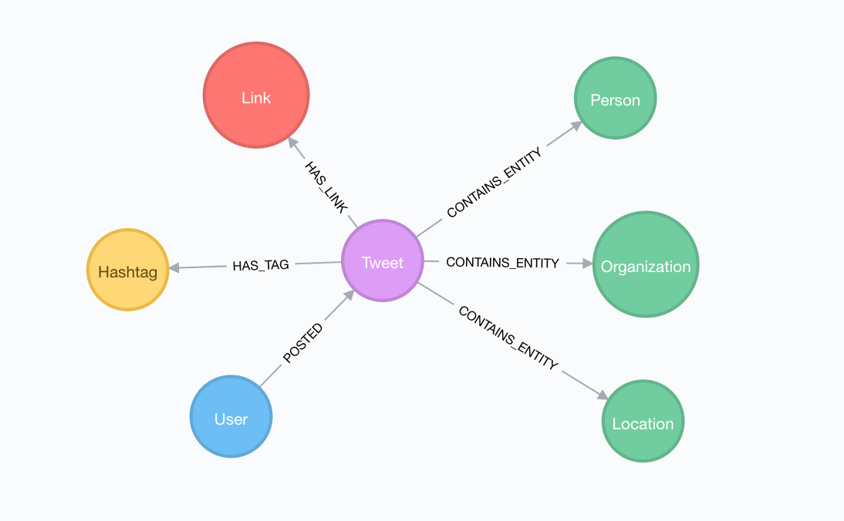
Text Networks
Mapping connections between text across a corpus
Variation in node/edge relationships
Word co-occurrence across sentences
Subjects/name entities/etc. across documents
Relationship ties across users
Particularly effective at identifying subcommunities across large text-based digital platforms

Slide 23
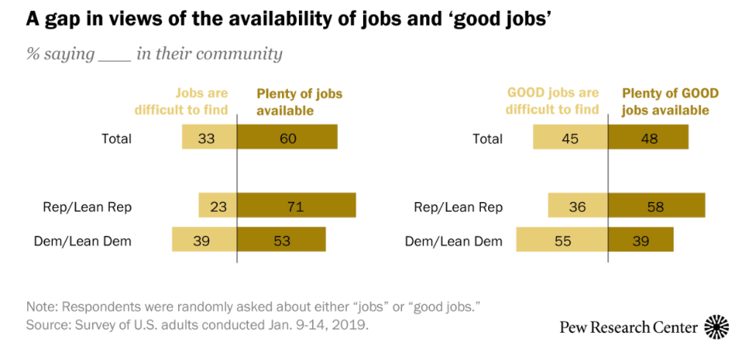
Causal Analysis
Text as treatment vs. Text as outcome
How does the distribution of survey answers change with slight variation in the question text?
How can text be used within matching to minimize confounding factors between natural experiment groups?

Slide 24
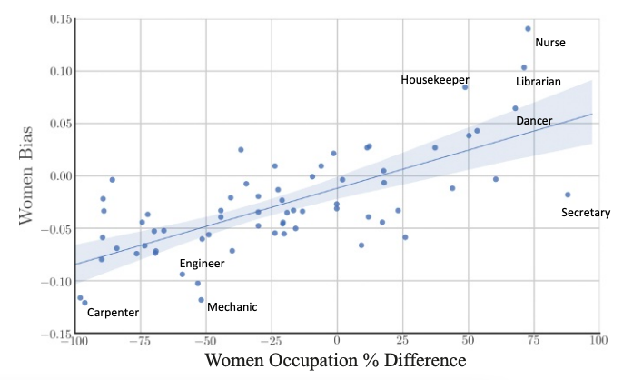
Ethics Within NLP
Text data is a fundamentally social product and is therefore embedded within structural inequities
Ability to reinforce discimination, stereotypes, bias
Unfortunately much ethical conversation in ML/NLP only is spotlighted after problems are retroactively discovered

Slide 25
Core Ethical Considerations
Digital trace data/computational methods present comparatively novel ethical concerns
What are expectations of user autonomy, privacy, informed consent?
What vulnerabilities are associated within the text and what are the risks towards individual harm?
How does the traditional relationship change between researcher and participants?
Taking proactive actions as researchers around:
De-identification/anonymity/paraphrasing
Data privacy
User agency/community participation

Slide 26
Future Directions / Conclusions
The abundance of digitized text is only growing across platforms and topics
While NLP tools grow in capability to handle complex language phenomena, the resources to use said methods are often open-sourced and increasingly accessible for a general audience
However, this also raises novel issues connected to ethics in the digital age
Social scientists are in a unique position to address essential questions with text data given our disciplinary perspectives
I hope this workshop may be a source of inspiration for your own research!

Slide 27
Upcoming CCSS Research Support Workshops
Machine Learning Series:
Supervised Learning in Python, Mar 28
Unsupervised Learning in Python, Apr 11
Additional Topics:
Documentation with R Studio/R Markdown, Mar 24
Structural Equation Modeling, Mar 25

Slide 28
Thank you! Questions?
Remy Stewart
CCSS Data Science Consultant
PhD Candidate in Sociology CCSS-ResearchSupport@cornell.edu
Drop by my virtual office hours from 10-11:30 AM Monday March 28th

